Slide 1

BEHAVIOURAL MODELS@ESO
L. Andolfato, M. Comin, S. Feyrin, M. Kiekebusch, J. Knudstrup, F. Pellegrin, D. Popovic, C. Rosenquist, R. Schmutzer

Slide 2

European Southern Observatory

Slide 3

ALMA Atacama Large Millimeter Array, 5000m, Atacama desert

Slide 4
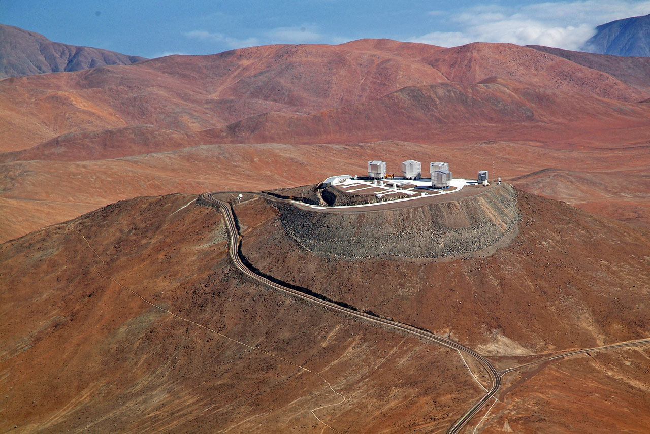
Very Large Telescopes Cerro Paranal, 2635m, Atacama desert, Chile.

Slide 5
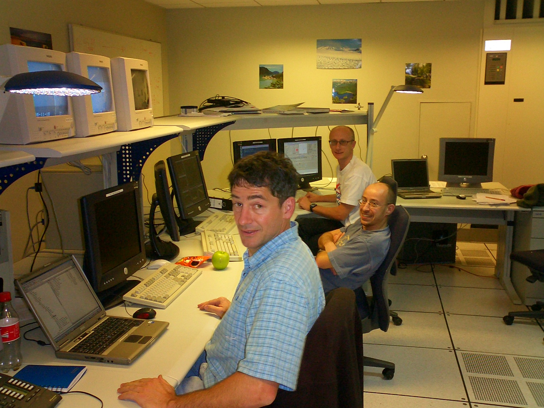
System Commissioning

Slide 6
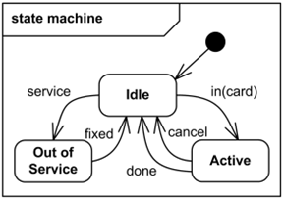

“BEHAVIOURAL MODELS FOR DEVICE CONTROL”
Digitally controlled shutters
Lamps with intensity control
DC and stepper motors
Multi-axis analog piezos

Slide 7
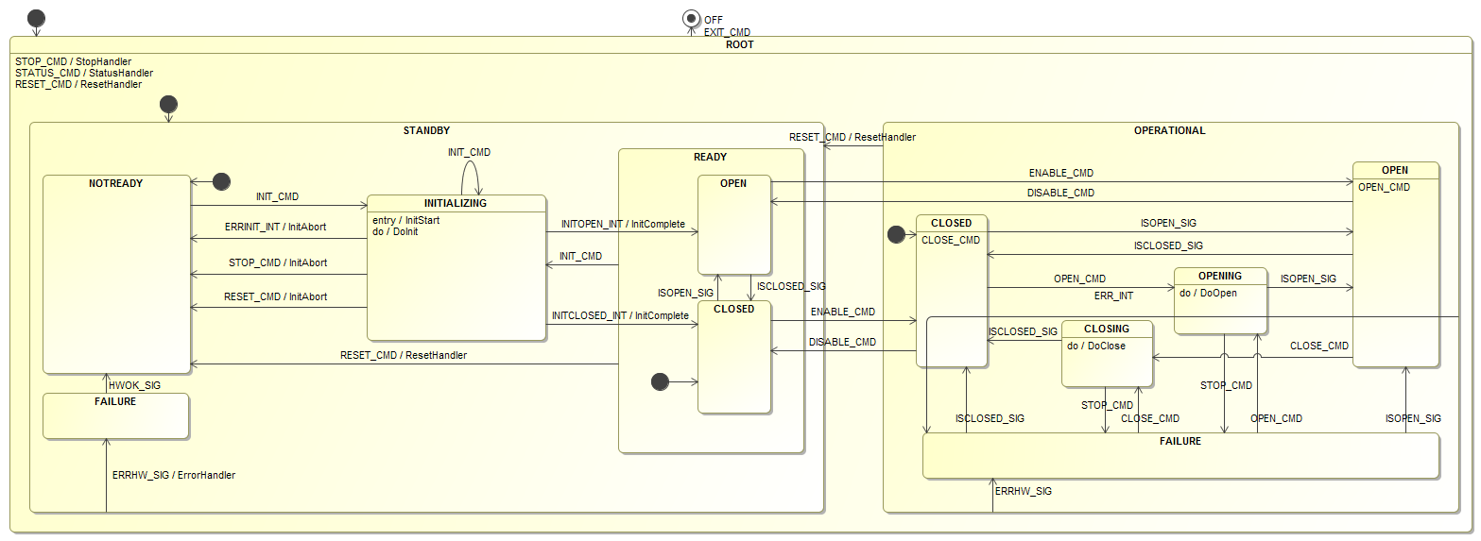
Shutter

Slide 8

How easy is to reuse models?
MODELS
RE-USE

Slide 9
Exchanging Models
Requires:
A precise modeling language
An open exchange format
Avoiding any project specific detail. (When not possible, explicitly state the constraints.)

Slide 10
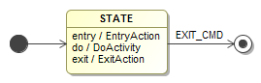
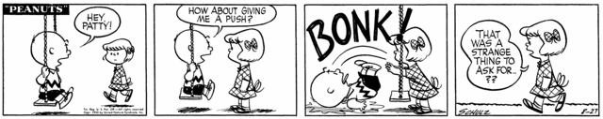
Precise Semantics
“When exiting a state, the do-activity should terminate.”
Upon the EXIT_CMD event:
1) Stop DoActivity
2) Invoke ExitAction
or
1) Invoke ExitAction
2) Stop DoActivity
Notes:
The most important of the 3 three conditions is, in my opinion, the selection of a precise modeling language.
In particular it is important to select a language that has precise semantic.
Consider the following Statecharts example: what happens when the EXIT_CMD is received? The notation simply specifies “When exiting a state, the do-activity should terminate.”, but what does it actually mean “exiting a state”? Is it before or after executing the ExitAction?
If we do not agree on the semantic we cannot exchange models.

Slide 11
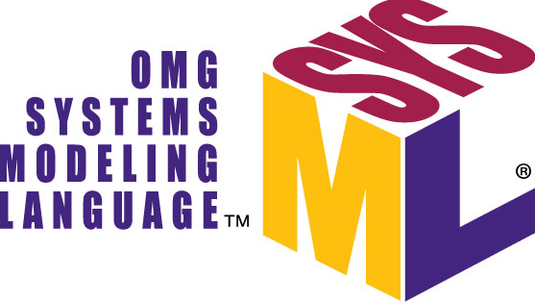


Open Formats
XMI
XMI
SCXML

Slide 12
Project Specific Information
Platform Independent Models (PIM): models should avoid assumptions on specific technologies/services.
Explicitly state the context and the driving forces behind the architectural / modeling decisions (like for the Design Patterns).

Slide 13
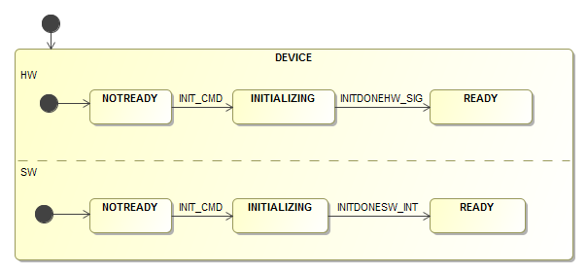
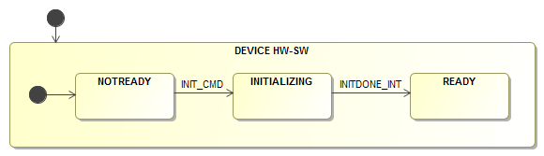
State Semantic
HW and SW have dedicated States in different orthogonal regions.
States represent “HW and SW together”.

Slide 14
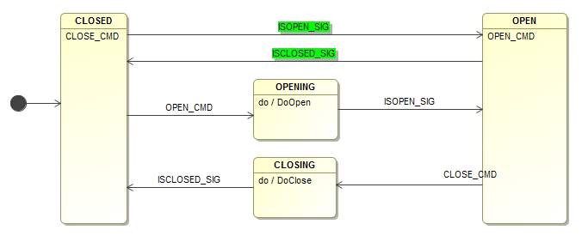
Events Priority
States represent “HW and SW together” with priority given to HW events/signals.

Slide 15
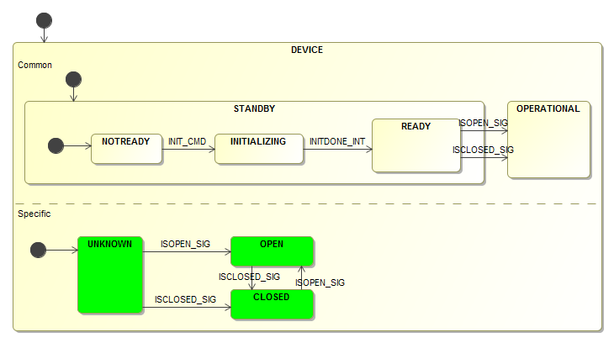
Common & Specific Behavior (using orthogonal regions)
Orthogonal region dedicated to device’s specific behavior.

Slide 16
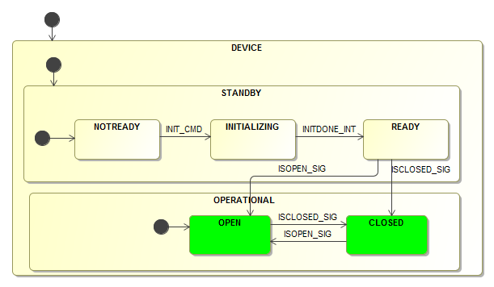
Common & Specific Behavior (using composite states)
Sub-states of OPERATIONAL are specific to the device.

Slide 17
Failure Management Strategies
Phase | Goal | Failure Effect
Startup / Initialization | Increase System Reliability | Triggers system re-initialization.
Operation | Increase System Availability | Allows for retries (does not force a re-initialization).

Slide 18
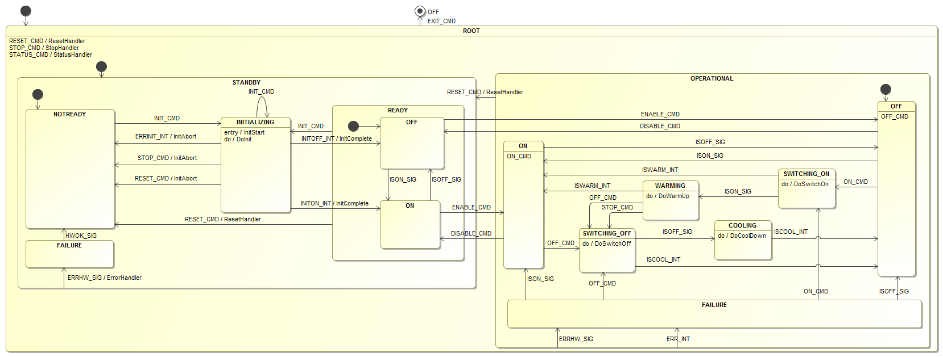
Lamp

Slide 19
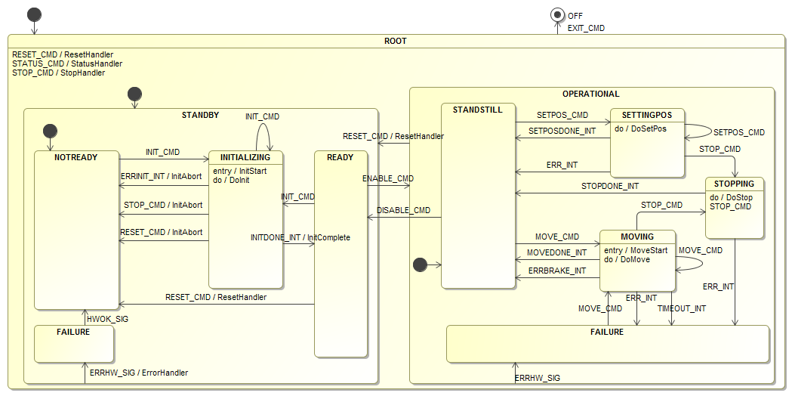
Motor

Slide 20
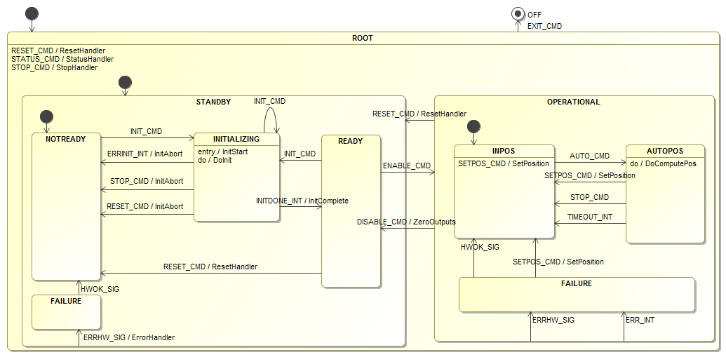
Piezo

Slide 21

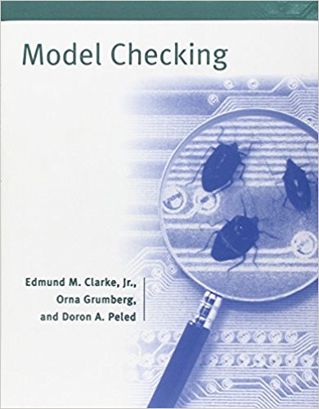




COMODO M2T Tool
COMODO
Formal Verification
Java Pathfinder
SysML Model + cmdoProfile
(EMF XMI)
SCXML Model
Transform into Code and Simulators for project specific SW Platforms
Execute the SCXML Model

Slide 22
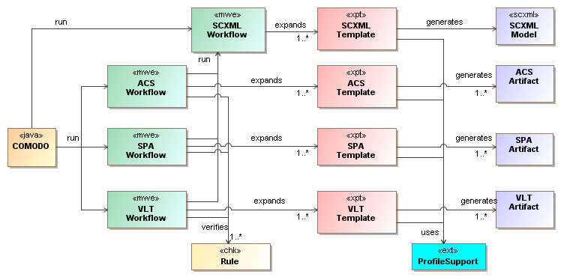
COMODO Insight
4) Xpand Templates generates the artifacts using Xtend functions
2) One workflow per platform + SCXML
1) Input:
Model
TargetPlatform
5) Xtend functions to help navigating the model
3) Verify Model is complete and unambiguous

Slide 23

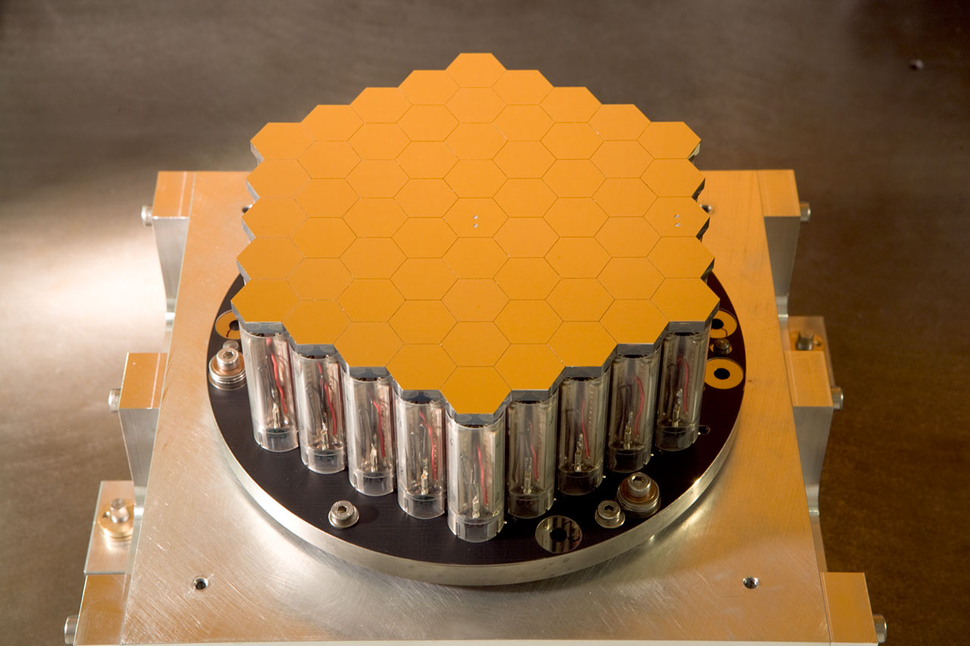
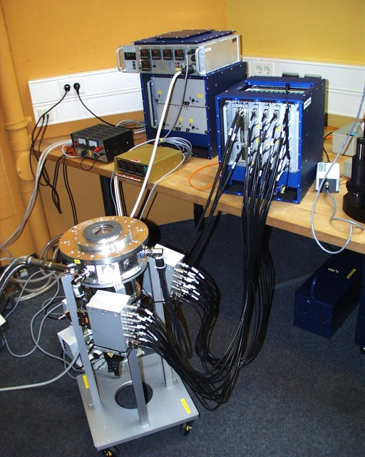
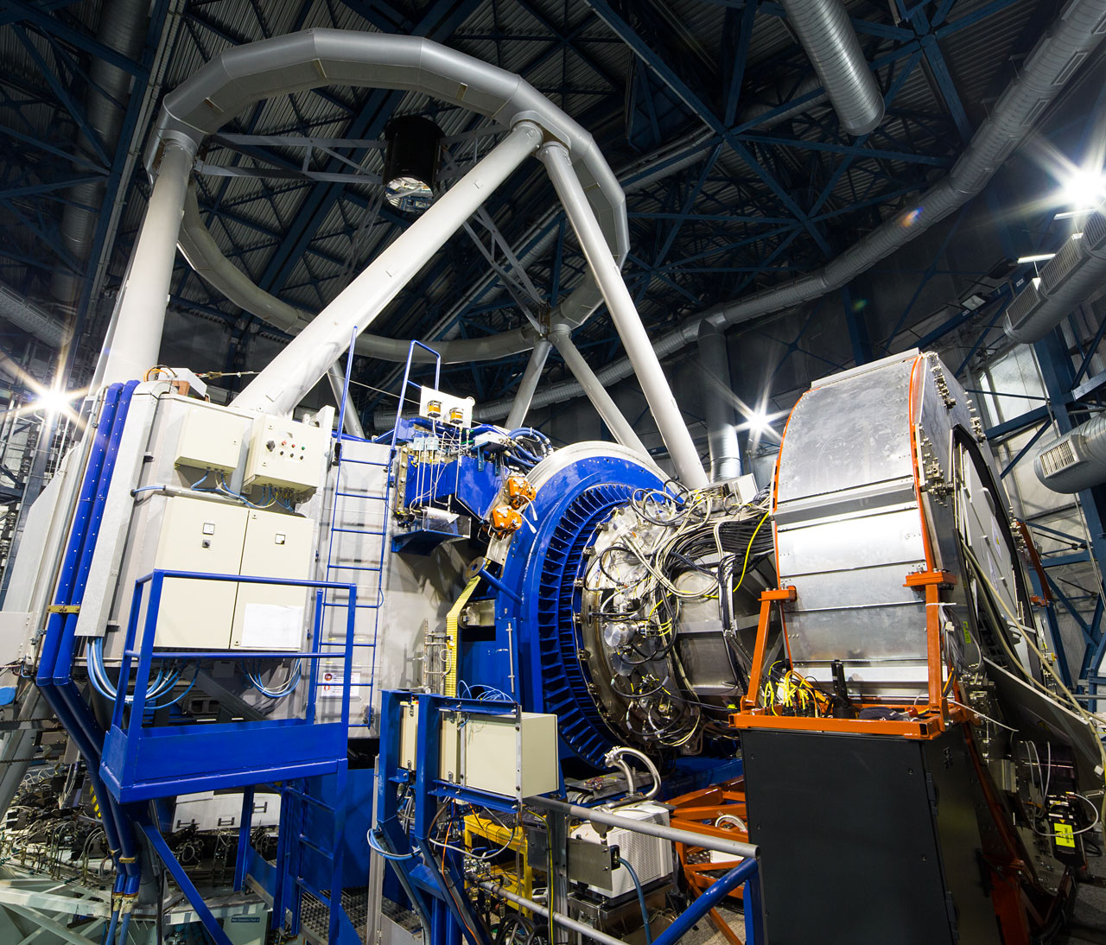
Projects using COMODO (Control SW Development)
ESO
Interferometer (AT, DL, …)
Active Phasing Experiment
Detectors Control
Instruments Control

Slide 24


Projects using COMODO (Rapid Prototyping)
ESO
VLT/ALMA (cross-platform prototyping)
ELT LSV prototype (prototyping platform Java + RabbitMQ)

Slide 25
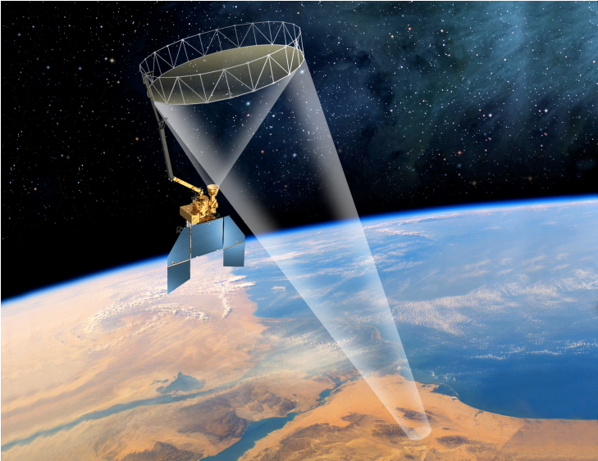
Projects using COMODO (Formal Verification)
ESO
- Variable Curvature Mirror
NASA/JPL
- Soil Moisture Active Passive

Slide 26
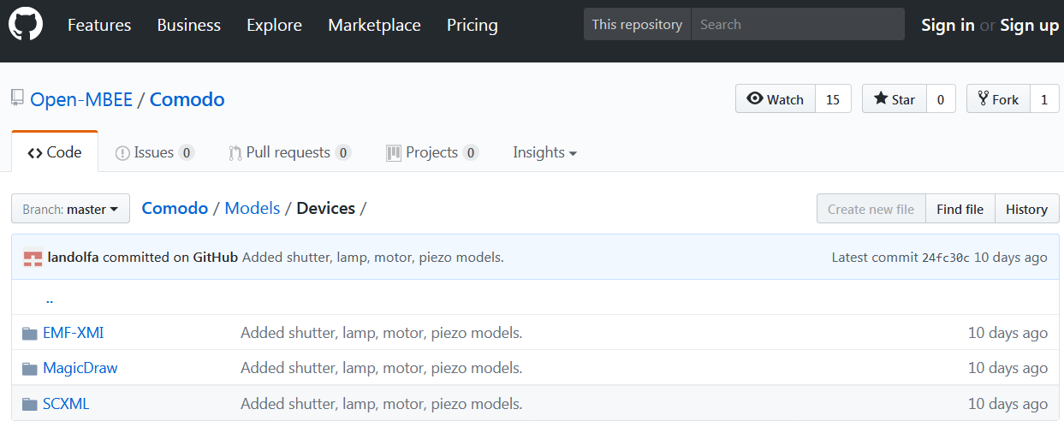
Where are the models / COMODO?
https://github.com/Open-MBEE/Comodo

